Slide 1
Entertainment Industry Analysis

Slide 2
Problem Statement:
Normal life can be stressful, and people need to relax. Being entertained by others is a wonderful way to take some time out of life. It can reduce stress and make life's issues easier to face. The media and entertainment industry consists of film, television, radio and print. These segments include movies, TV shows, radio shows, news, music, newspapers, magazines, and books. The entertainment industry is a group of sub-industries devoted to entertainment. The entertainment industry is used to describe the mass media companies that control the distribution and manufacture of mass media entertainment.

Slide 3
Objective
The goal is to analyze a dataset of entertainers to uncover patterns related to their career spans, breakthrough ages, and the ages at which they receive major awards. The analysis will also explore trends over time and differences based on gender.
SIGNIFICANCE
For Industry Stakeholders: Understanding these trends can help the industry foster talent and manage careers more effectively.
Further Research: Expanding the dataset and including more recent data could yield additional insights into modern entertainment trends.

Slide 4
Data Overview
The dataset contains the following columns:
Entertainer: Name of the entertainer.
Gender (traditional): Gender of the entertainer.
Birth Year: Year of birth.
Year of Breakthrough/#1 Hit/Award Nomination: Year of major breakthrough.
Breakthrough Name: Name of the work that marked the breakthrough.
Year of First Oscar/Grammy/Emmy: Year of the first major award.
Year of Last Major Work (arguable): Year of last significant work.
Year of Death: Year of death (if applicable).

Slide 5


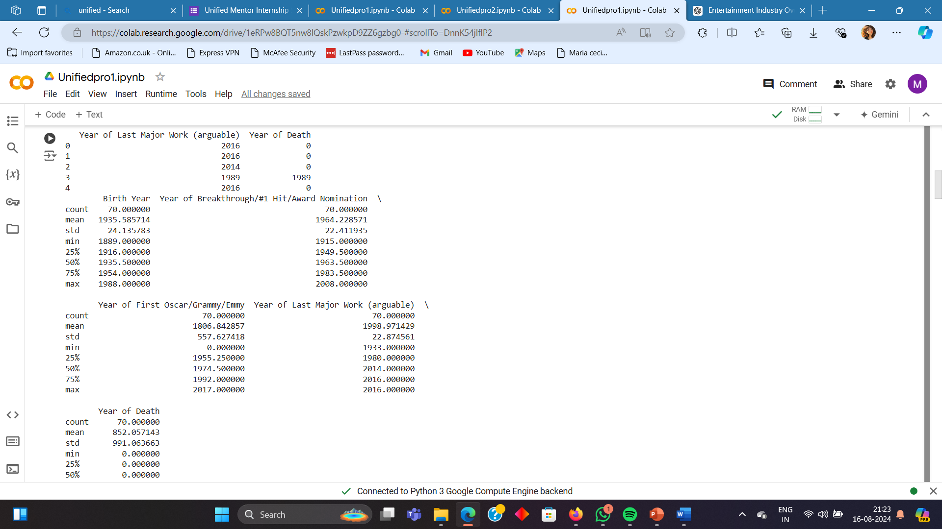
DATA PROCESSING

Slide 6

DATA CLEANING

Slide 7
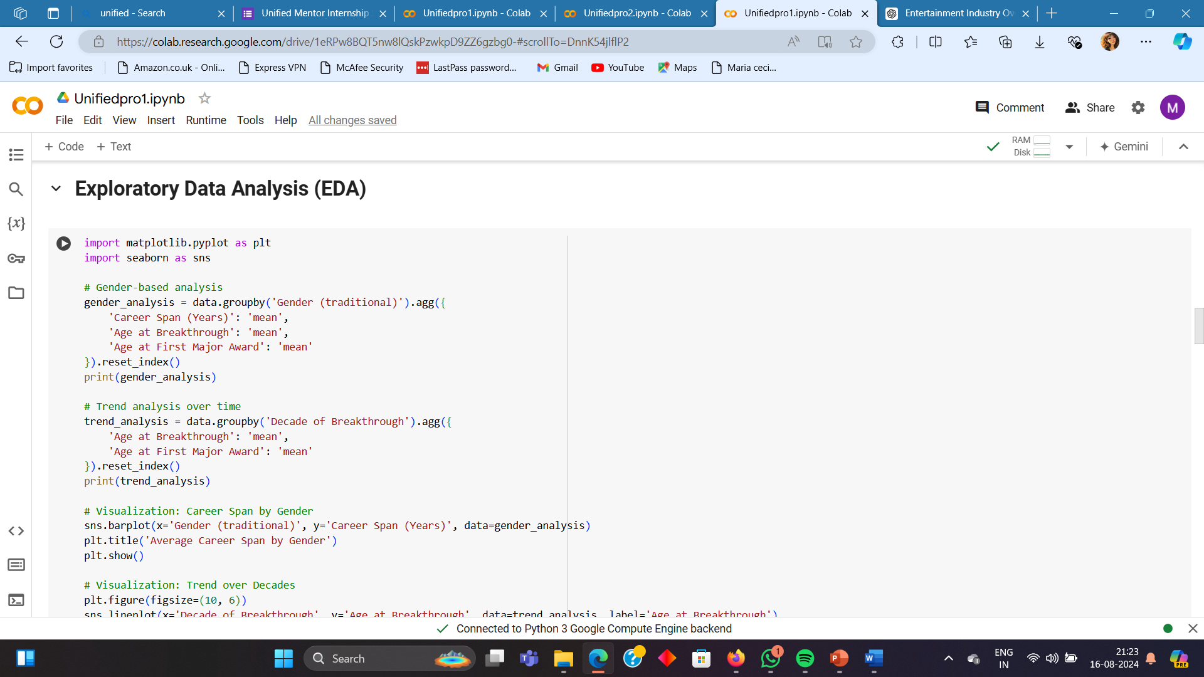
DATA ANALYSIS

Slide 8
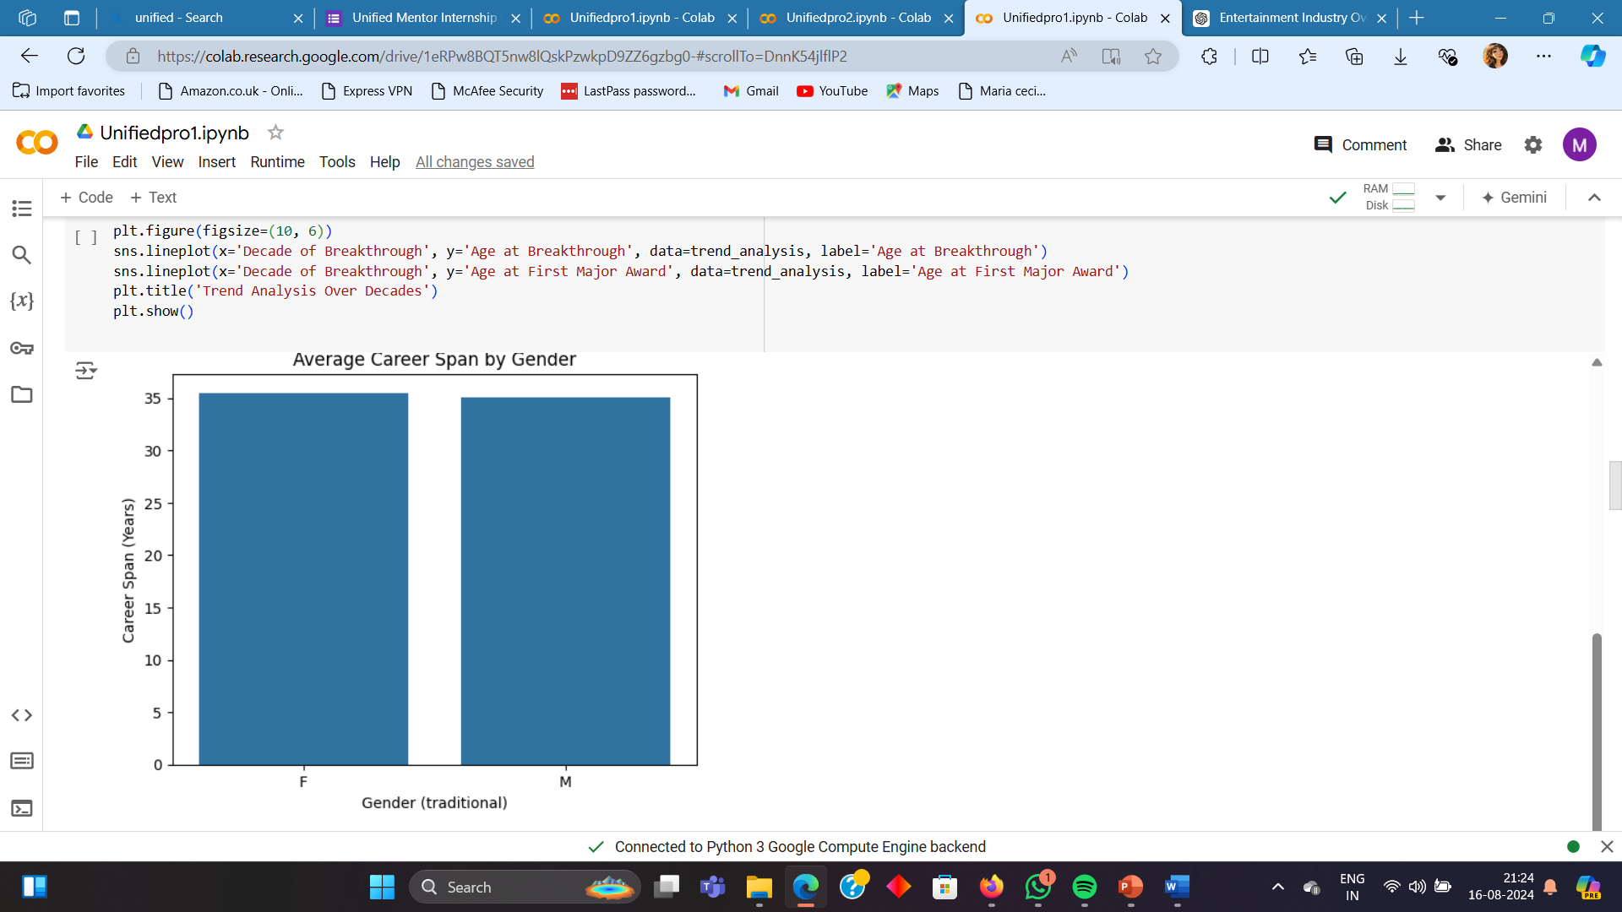
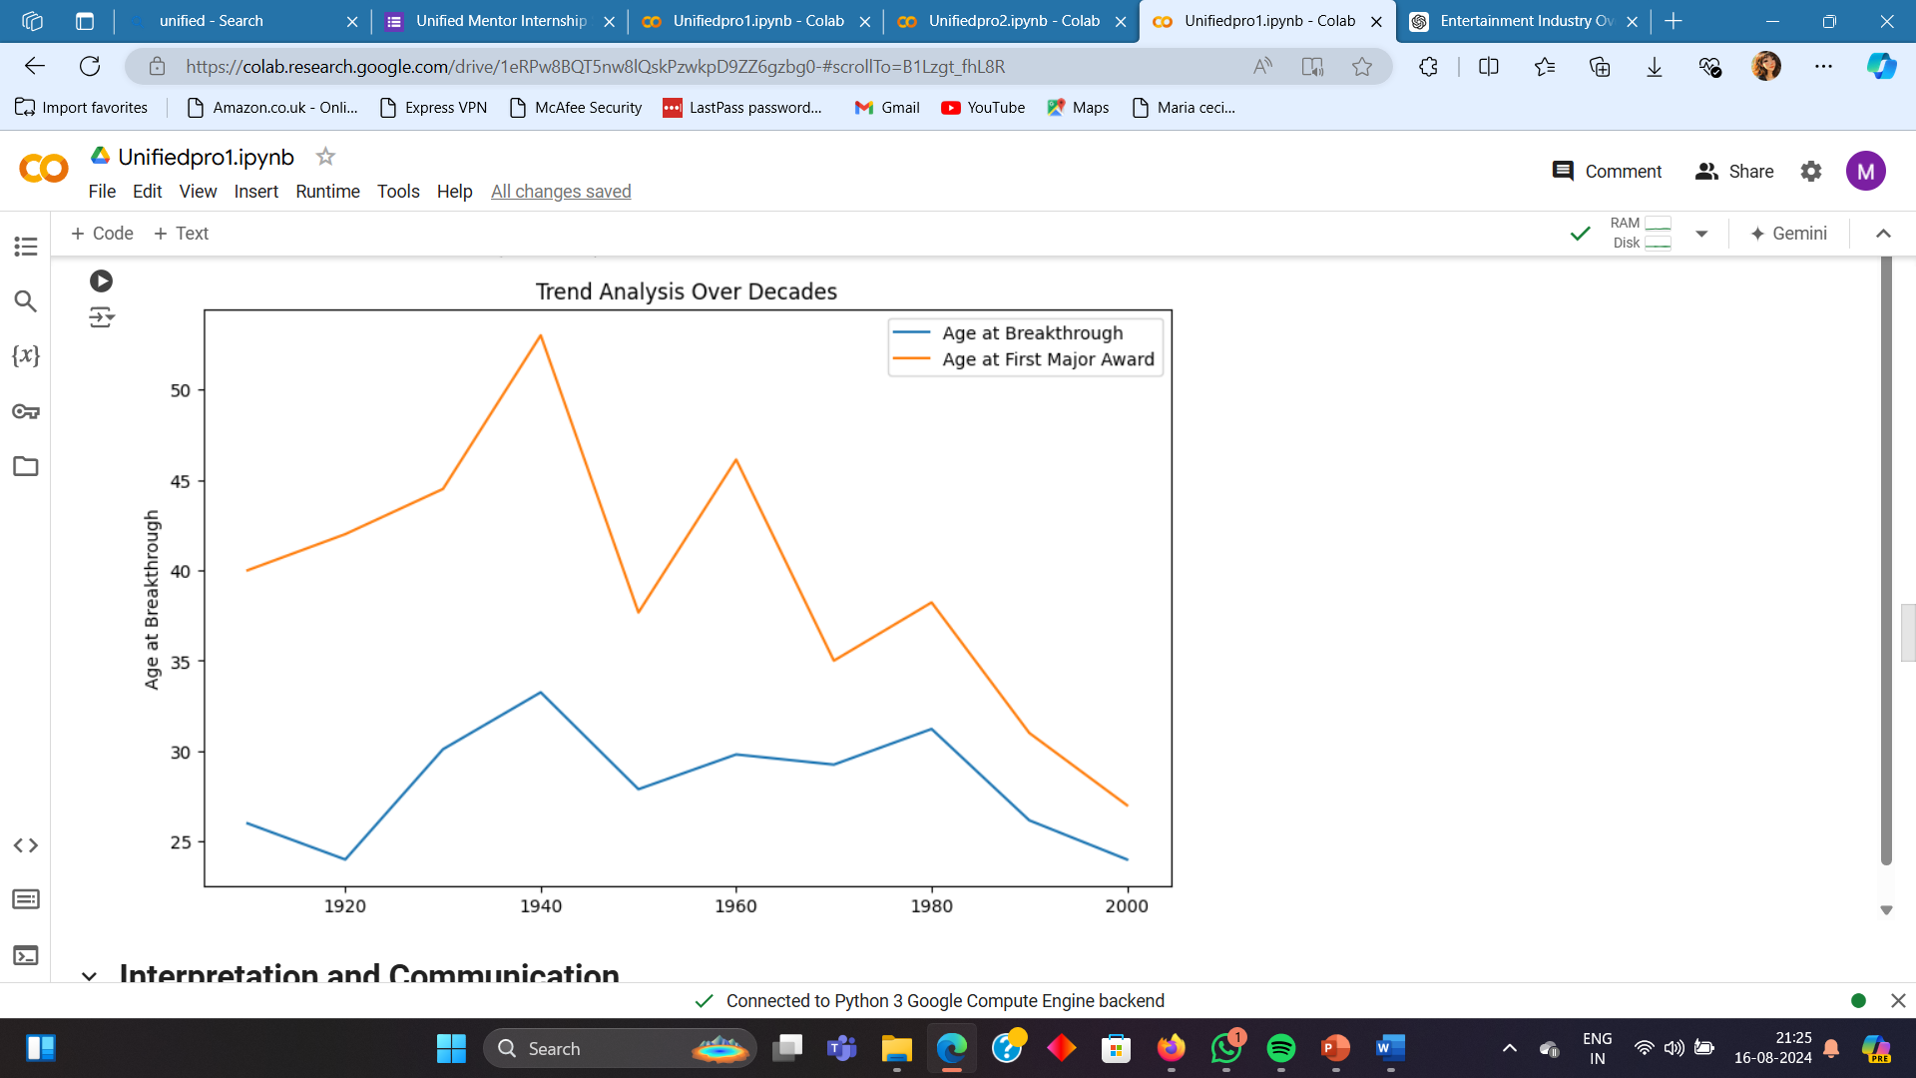

Slide 9

INSIGHT OF DATASET

Slide 10
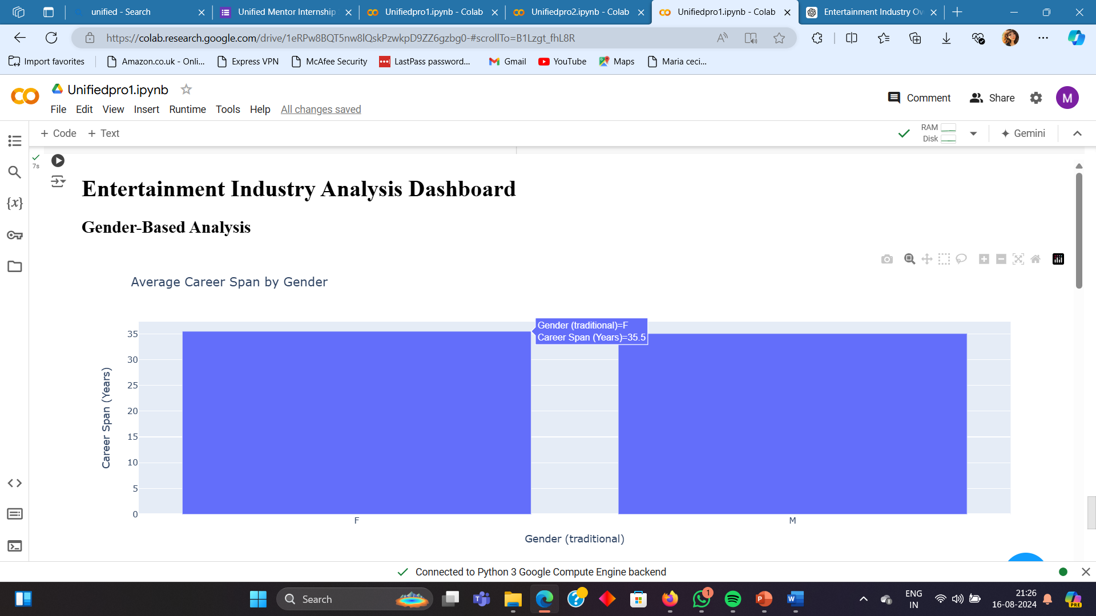
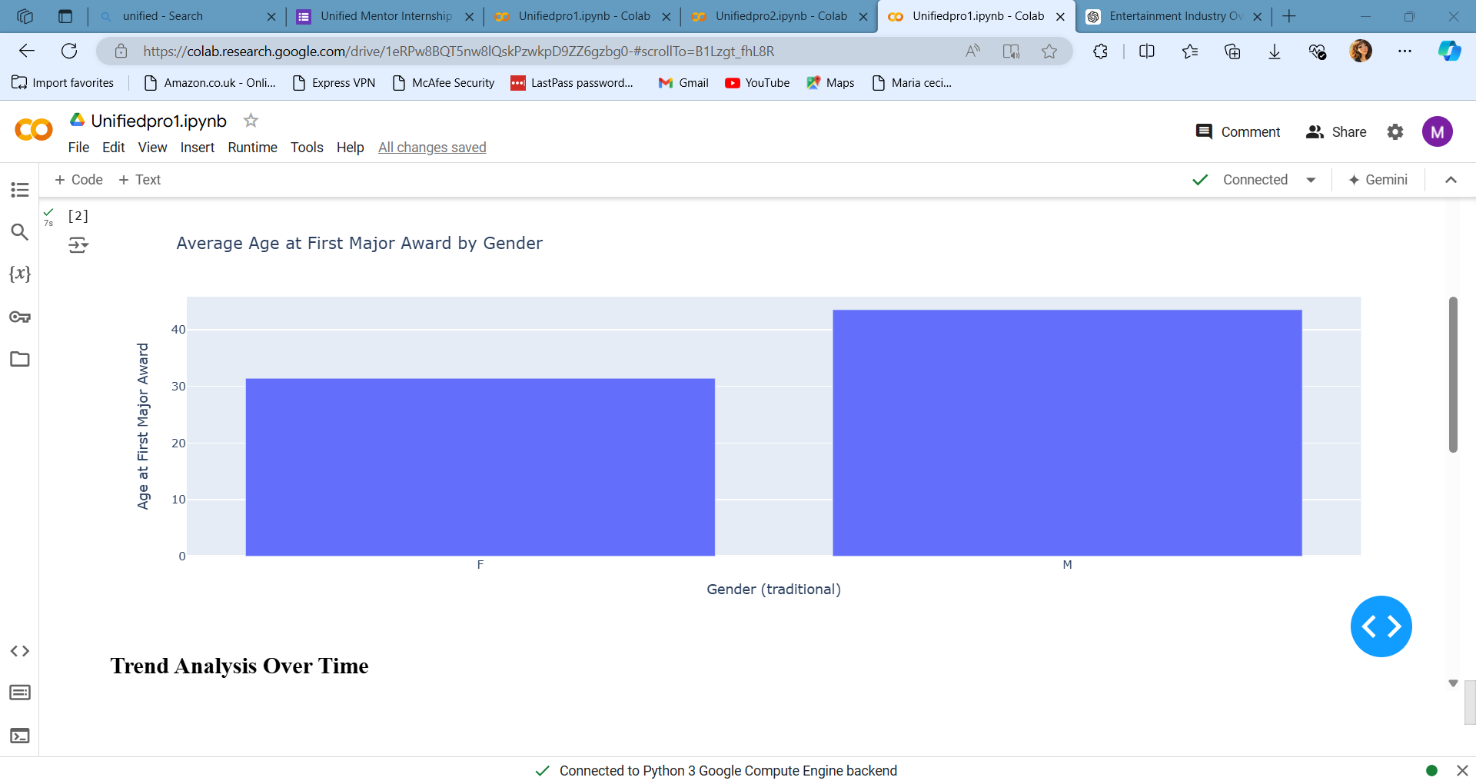
DASHBOARDS

Slide 11
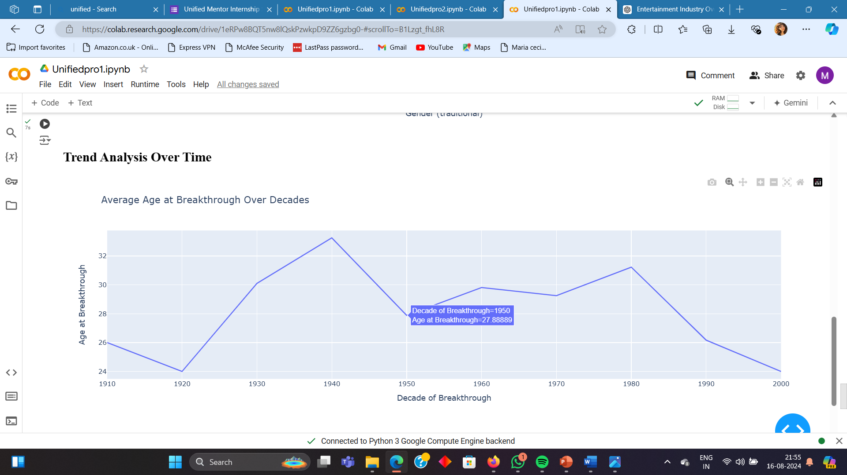
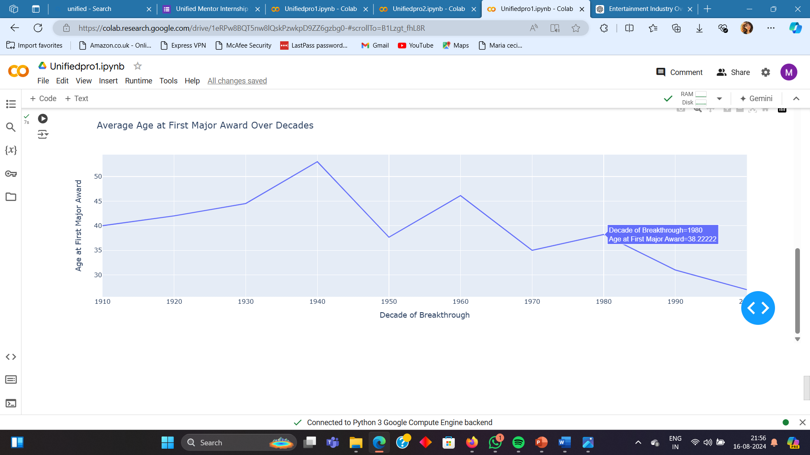

Slide 12
Conclusion
Gender Differences: Male entertainers generally have a longer career span and a later breakthrough age compared to female entertainers.
Trends Over Time: The average age at breakthrough and at the first major award has varied across decades, with recent decades showing a decrease in breakthrough age.

